Slide 1
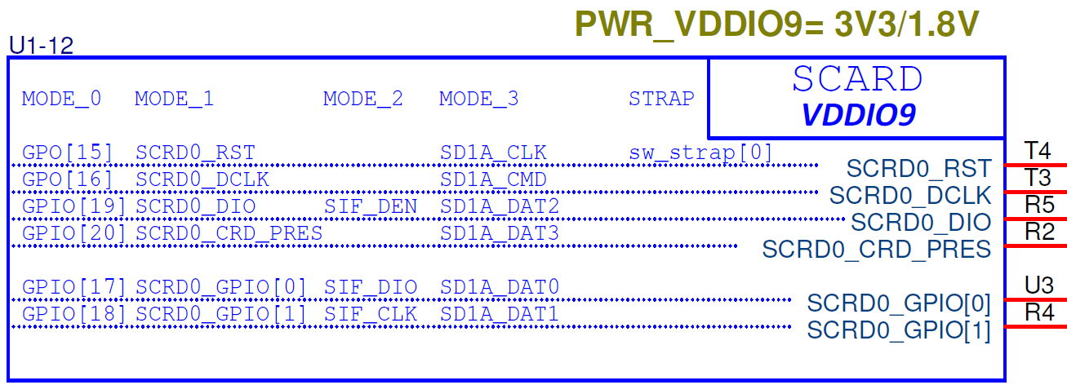
VS-550
USB2.0 Switch
(N/I)
A113X
USB2.0 DS
USB2.0
Reset(HUB_RSTn)
USB2.0 Hub
USB2.0 DS
USB2.0
USB2.0
USB3.0
USB2.0
USB2.0
USB3.0 Connector
BT5.0
USB2.0 Connector

Slide 2
V33
R3013
NI
USB2.0 Hub
Reset(HUB_RSTn)
R3000
R2999
C1400
NI
Current Design
R3000: 0 ohm, R3013: NI, R2999: 4.7K ohm, C1400: NI
Question
When SoC control reset signal for USB2.0 Hub during operation?
If no(USB Hub always reset at power on),
we want to change below status
R3000: NI, R3013: 10K ohm, R2999: NI, C1400: NI

